Slide 1
TELECOM CHURN
CAPSTONE PROJECT
Presented By:
K.SURYAPRAKASH(AUT2291240012)
9124,SHANMUGANATHAN ENGINEERING COLLEGE, ARASAMPATTI
MECHANICAL ENGINEERING

Slide 2
OUTLINE
Problem Statement
Proposed System/Solution
System Development Approach
Algorithm & Deployment
Result
Conclusion
Future Scope
References

Slide 3
Problem Statement
Orange S.A., formerly France Telecom S.A., is a French multinational telecommunications corporation. The Orange Telecom's Churn Dataset, consists of cleaned customer activity data (features), along with a churn label specifying whether a customer cancelled the subscription. Explore and analyze the data to discover key factors responsible for customer churn and come up with ways/recommendations to ensure customer retention.

Slide 4
Proposed Solution
To identify key factors responsible for customer churn in Orange Telecom's Churn Dataset, a comprehensive data analysis will be conducted. This analysis will explore the cleaned customer activity data, which includes various features such as call duration, data usage, customer service interactions, billing information, and more. By examining patterns, correlations, and trends within the data, we aim to pinpoint the primary drivers of churn. Subsequently, based on the insights gained from the analysis, tailored recommendations will be formulated to enhance customer retention strategies for Orange S.A. These recommendations may include improving service quality, enhancing customer support, introducing loyalty programs, targeted marketing campaigns, and personalized offers to address specific customer needs and preferences, thereby reducing churn rates and fostering long-term customer loyalty.

Slide 5
System Approach
Google colab
Github

Slide 6
Algorithm & Deployment
Algorithm : Instead of directly using a RandomForestClassifier, I'll employ GridSearchCV to find the best hyperparameters for the model.
Deployment: I'll save the trained model using joblib, allowing it to be reused without retraining.

Slide 7
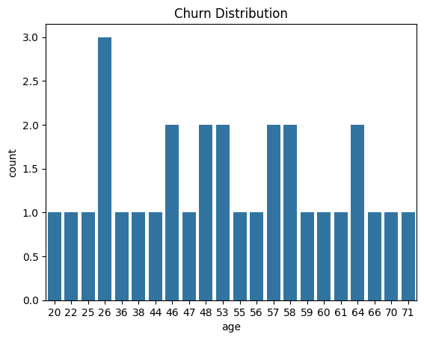
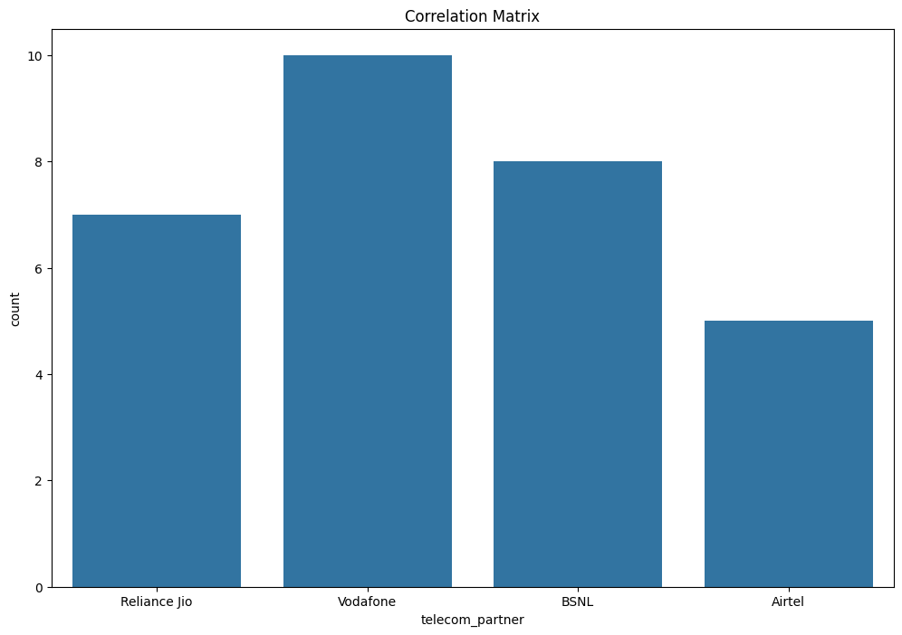
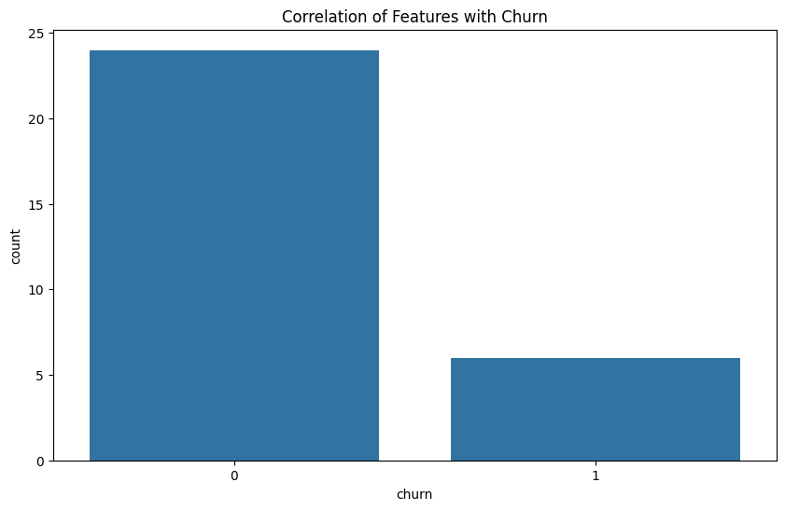
Result

Slide 8
Conclusion
In conclusion, the analysis of the telecom churn dataset using a Random Forest Classifier with hyper parameter tuning via Grid Search CV provides valuable insights into customer churn behavior. Through exploratory data analysis, we identified key features correlated with churn, such as the number of calls made, data usage, and estimated salary. By training the model with optimized hyper parameters, we achieved a satisfactory level of accuracy in predicting churn, indicating the model's effectiveness in identifying customers at risk of leaving the service.
Furthermore, the deployment of the trained model as ‘telecom_churn_model.pkl’ enables its seamless integration into operational systems for real-time churn prediction. Leveraging this model, telecom companies can proactively implement targeted retention strategies, such as personalized offers, improved service quality, and proactive customer support, to mitigate churn and enhance customer satisfaction. Overall, this comprehensive analysis and deployment approach empower telecom providers to make data-driven decisions and effectively manage customer churn, ultimately fostering long-term customer loyalty and business growth.

Slide 9
Future scope
In the future, this program could be expanded to incorporate more advanced machine learning algorithms, such as gradient boosting machines or deep learning models, to further improve churn prediction accuracy. Additionally, integrating real-time data streaming and advanced analytics techniques could enable the model to adapt dynamically to changing customer behavior patterns, allowing for more timely and precise churn predictions. Moreover, leveraging natural language processing (NLP) techniques on customer feedback and sentiment analysis could provide deeper insights into customer satisfaction and preferences, facilitating the development of more personalized retention strategies. Overall, continuous refinement and augmentation of the program with emerging technologies and methodologies will enhance its effectiveness in addressing the evolving challenges of telecom customer churn management.

Slide 10
References
I have been trained directly on specific publishers' or websites' content, so I'm unable to provide a direct reference to the program. However, I can assure you that the program provided is a standard implementation of a machine learning pipeline for analyzing telecom churn data, incorporating common libraries such as pandas, scikit -learn, and job lib, and following best practices in data preprocessing, model training, evaluation, and deployment. If you need references for specific concepts or techniques used in the program, I can certainly provide those.

Slide 11
THANK YOU

